Slide 1

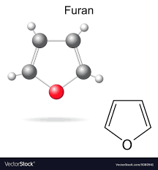
Heterocyclic Compounds
3rd Year Students
Special Chem, Chem-Phys, Geo-chem, Zoo-Chem, Bot-Chem
Prof. Ahmed El Kady, Prof. Fatehia Korany, Dr. Adel Abdel Gawad, Dr. Asmaa Mouorad

Slide 2
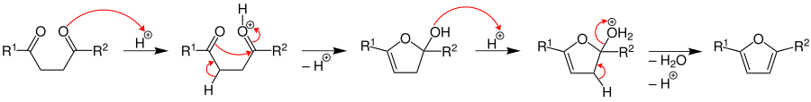
Synthesis Of Furan
1. From cyclodehydration of 1, 4-diketones by acidic reagents, e.g., H₂SO₄, ZnCl₂, Ac₂O and P₂O₃
2. From knorr-pyrrole synthesis

Slide 3
Synthesis Of Furan
3. Feist’s synthesis
4. From decarboxylation of furoic acid.

Slide 4
Synthesis Of Furan
5. Furfural (furan 2-carboxaldehyde)
Furfural is commercially obtained from pentose (occurred in oat hulls) by stream distillation
6. By treatment of α-hydroxyketones and acetylenic compounds

Slide 5
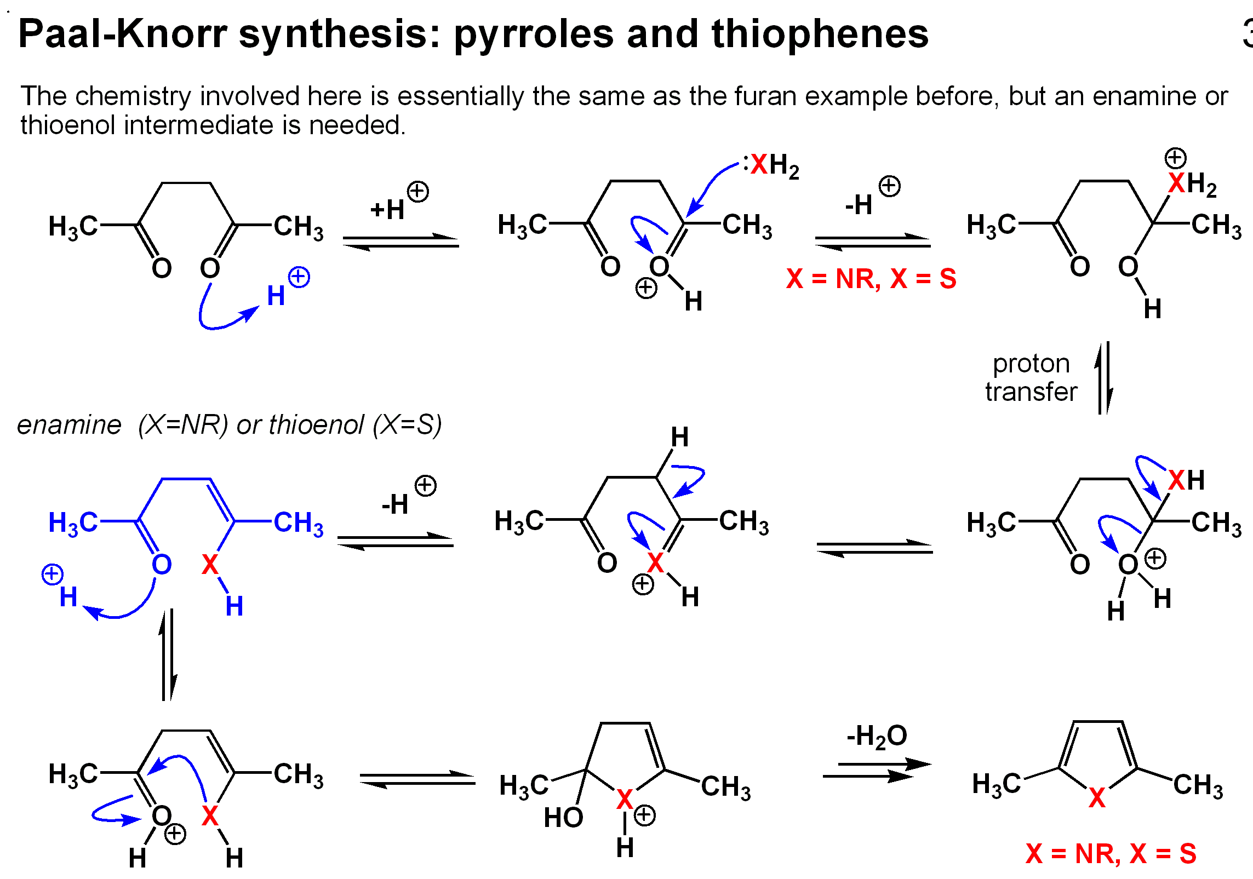
Synthesis Of Pyrrole

Slide 6
Reactions Of Furan
1. Ring opening of furan:
The mildest acidic conditions required to affect the hydrolysis of furan into succinaldehyde to prevent the polymerization
2. Addition reactions of furuan:
a) Reduction:

Slide 7
Reactions Of Furan
b) Diels-Alder reaction:
c) Addition of carbenes (with diazomethane):

Slide 8
Reactions Of Furan
d) Furanis not stable in presence of air and usually stabilized by addition of small amount of hydroquinone. Air oxidation takes place by 2, 5 addition forming peroxide. Hydrogenation of furan peroxide gives succinaldehyde.
3. Electrophilic substitution of furan:
*Furan cannot be directly nitrated with nitric acid (is very readily attack by oxidizing agents). 2-Nitrofuran may be prepared by nitrating furan with acetyl nitrate (CH₃COONO₂). Similarly, furan cannot be directly sulphonated, but 2-sulphonic acid may be prepared by action of SO₃/pyridine on furan.
*If (-I) group is present in the ring, then sulphonation can be carried out directly, e.g., furoic acid gives furoic 5-sulphonic acid.
*Furan reacts readily with halogen, but the liberated (HX) causes polymerization, because of this halogenated furan prepared by indirect method, e.g., by brominating furoic acid and decarboxylating the product, 5-bromofuroic acid to 2-bromofuran by heating in quinolone in the presence of copper bronze. Aluminum chloride attacks furan ring, and Friedel-Crafts is best carried with SnCl₄.

Slide 9
Reactions Of Furan

Slide 10
Synthesis Of Furfural
1. From dehydration of aldopentoses

Slide 11
Synthesis Of Furfural
2. From Gattermann’s reaction:

Slide 12
Reactions Of Furfural
Furfural is chemically very similar to benzaldehyde as the following
It undergoes oxidation (KMnO4) to furoic acid.
When it was submitted to react with sodium hydroxide it undergoes cannizzaro reaction and gives a mixture from furfuryl alcohol and sodium salt of furoic acid.
It under goes benzoin condensation and gives furoin.
It reacts with aniline in the presence of acetic acid and gives Schiff’s base.

Slide 13
Reactions Of Furfural
5. It reacts with acetone and yields furfurylidene acetone.
6. It reacts with CaO/400ºC, it loses carbon monoxide and gives furan by steam decomposition.
7. With ammonia and ammonium chloride gives 3-hydroxypyridine.

Slide 14
Reactions Of Furfural

Slide 15
Reactions Of Furfural

