Slide 1
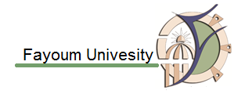
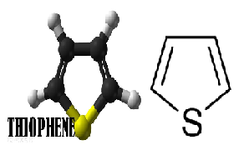
Heterocyclic Compounds
3rd Year Students
Special Chem, Chem-Phys, Geo-chem, Zoo-Chem, Bot-Chem
Prof. Ahmed El Kady, Prof. Fatehia Korany, Dr. Adel Abdel Gawad, Dr. Asmaa Mouorad

Slide 2

Synthesis Of Thiophene
1. From Paal-Knorr synthesis
2. From action of sulphur on butane

Slide 3
Synthesis Of Thiophene
3. By distilling sodium succinate with P₂S₅
4. By treatment of diacetylenes with hydrogen sulphide in basic conditions

Slide 4
Reactions Of Thiophene
Thiophene resembles benzene, rather than furan or pyrrole in many of its reactions.
1. Addition reaction:
a) Thiophene is stable to aqueous, but not to anhydrous mineral acids which causes polymerization.
b) Reduction: thiophene is reduced by sodium and alcohol to give 2,3-dihydrothiophene and 2,5-dihydrothiophene, but catalytic reduction of thiophene yielding n-butane and H₂S.
c) Thiophene doesn’t undergo Diels-Alder reaction.

Slide 5
Reactions Of Thiophene
d) Thiophene forms addition products with halogens, it reacts with chlorine at 40°C yielding addition product; tetrachlorotetrahydro thiophene, with substitution products 2-chloro or 2,5-dichlorothiophene.
e) Oxidation.

Slide 6
Reactions Of Thiophene
2. Electrophilic substitution reactions with thiophene

Slide 7
Applications of Pyrrole, Furan, and Thiofene
1-Pyrrole
Porphyrins
Porphin is the parent chemical compound for types of biochemically significant compounds called porphyrins. The chemical formula of porphin is C20H14N4. Porphin is an organic compound that is aromatic and heterocyclic since its chemical structure, essentially consists of four pyrrole rings joined together by four methine (=CH—) groups to form a larger macrocycle ring. The compound itself is a solid.

Slide 8
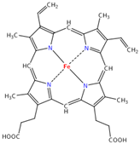
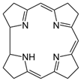
Applications of Pyrrole, Furan, and Thiofene
Examples of Porphyrins
Heme B group of hemoglobin: An iron (Fe) atom in the middle is complexed to four interior nitrogen atoms.The specific porphyrin in heme B is called protoporphyrin IX and has 4 methyl, two vinyl, and two propionic acid substituents.
Corrin is aheterocyclic compound. It is the parent macrocycle related to substituted derivative that is found in vitamin B12

Slide 9
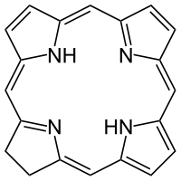
Applications of Pyrrole, Furan, and Thiofene
Chlorin is a large heterocyclicaromatic ring consisting, at the core, of three pyrroles and one pyrroline coupled through four =CH- linkages. Unlike porphin, the central aromatic ring structure of porphyrins, a chlorin is therefore largely aromatic but not aromatic through the entire circumference of the ring.
Chlorophyll is a chlorin pigment, at the center of the chlorin ring is a magnesiumion; the chlorin ring can have several different side chains, usually including a long phytol chain.

Slide 10
Applications of Pyrrole, Furan, and Thiofene
2- Furfural
Furfural is used on a large scale as a solvent for refining lubricating oils, and for removing butadiene from its mixture with butene and butane.
3- Thiofene
Biotin, also known as vitamin H or coenzyme R, is a water-soluble B-vitamin (vitamin B₇).It is composed of a ureido (tetrahydroimidizalone) ring fused with a tetrahydrothiophene ring. A valeric acid substituent is attached to one of the carbon atoms of the tetrahydrothiophene ring. Biotin is a coenzyme for carboxylase enzymes, involved in the synthesis of fatty acids, isoleucine, and valine, and in gluconeogenesis.

Slide 11
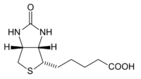
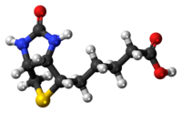
Applications of Pyrrole, Furan, and Thiofene
Biotin is necessary for cell growth, the production of fatty acids, and the metabolism of fats and amino acids. Biotin assists in various metabolic reactions involving the transfer of carbon dioxide. It may also be helpful in maintaining a steady blood sugar level.it presents in egg yolk.

